Slide 1
User Interface Development
Lecture 5

Slide 2
Content
Dynamic data structures
  Array Lists
  Linked List
  Stacks, Trees
  Maps (tables)

Slide 3
Efficiency of Data Structures
Required storage space (memory)
Required running time for algorithms applied on data structures
  In practise these differences increase substantially with the data size

Slide 4
Comparing Data Structures
Data structures largely influence the efficiency of operations (algorithms) on data
For well-known operations performance indications for data structures can be obtained theoretically
For other operations benchmarking might be needed to establish most efficient data structure

Slide 5
Benchmark
Class | Add | Iterate | Remove
ArrayList | 0 ms | 660 ms | 2360 ms
LinkedList | 50 ms | 1100 ms | 0 ms
TreeSet | 330 ms | 1430 ms | 60 ms
HashSet | 110 ms | 1430 ms | 50 ms
http://java.sun.com/docs/books/performance/1st_edition/html/JPAlgorithms.fm.html

Slide 6
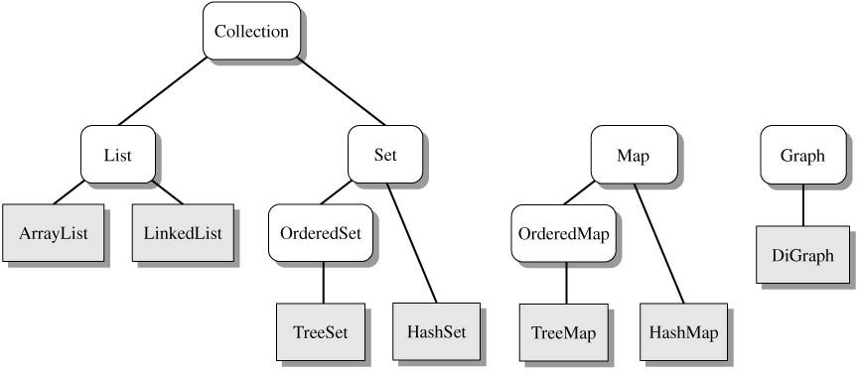
Java Collection Framework
Group of collections defined using interfaces, abstract classes, and inheritance.

Slide 7
ArrayList
Consider limitations of Java arrays
  Array length is not dynamically changeable
  Possible to create a new, larger array and copy elements – but this is awkward
A more elegant solution is to use an instance of ArrayList since its length is changeable at run time.

Slide 8
ArrayList
Drawbacks of using ArrayList
  Less efficient than using an array
  Can only store objects
  Cannot store primitive types

Slide 9
ArrayList
Elements can be added
  At end
  At beginning
  In between items
Possible to edit, delete, access, and count entries in the list

Slide 10
ArrayList
Necessary to
import java.util.ArrayList;
Create and name instance
ArrayList<String> list =
new ArrayList<String>(20);
This list will
  Hold String objects
  Initially hold up to 20 elements

Slide 11
ArrayList
Object of an ArrayList used like an array
  But methods must be used
  Not square bracket notation
Given
ArrayList<String> aList =
new ArrayList<String> (20);
  Assign a value with
  aList.add(index, "Hi");
  aList.set(index, “Bye");

Slide 12
LinkedList
Linked data structure
  Collection of objects
  Each object contains data and a reference to another object in the collection
Java provides a class for this: LinkedList
  More efficient memory use than ArrayList
  Faster inserting and deleting elements than ArrayList (see next slide)

Slide 13
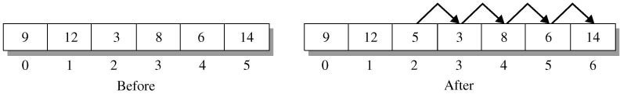
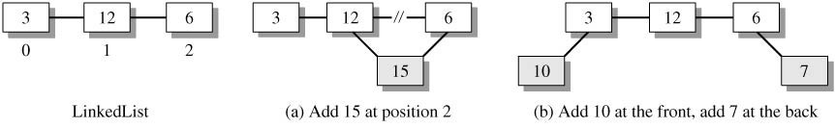
LinkedList
ArrayList: The collection efficiently (O(1)) inserts and deletes elements at the rear of the list. The operations at intermediate positions have O(n) efficiency since the tail of the list must be shifted right (insertion) or left (deletion).
LinkList: Inserting or deleting elements in a LinkedList involves altering the links that connect the elements in the list. These are O(1) operations.

Slide 14
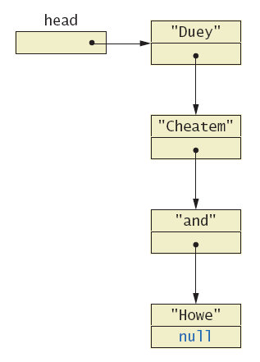
LinkedList
Links items
in a list to one
another
Node of a linked list object requires
=two instance variables
  data
  Link to next object

Slide 15
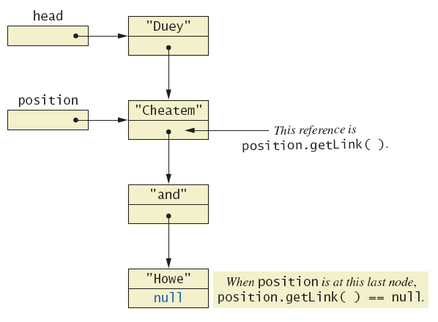
LinkedList
Moving down a
linked list

Slide 16
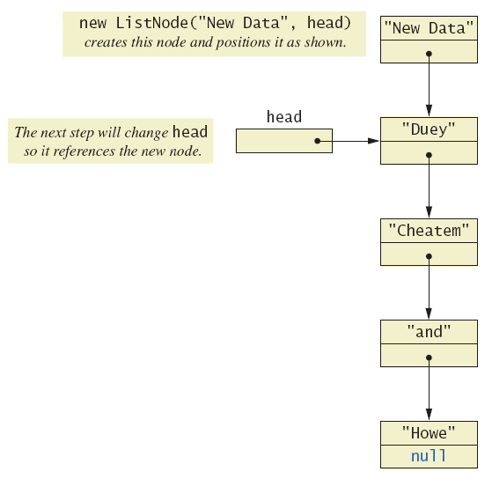
LinkedList
Adding a node
at the start of
a linked list
Java automatically returns memory used by deleted node to the operating system.
  Called automatic garbage collecting

Slide 17
Iterator
A variable that allows you to step through a collection of nodes in a linked list
Interface named Iterator with methods
  hasNext – returns boolean value
  next – returns next element in iteration
  remove – removes element most recently returned by next method
LinkedList < String > list2 = new LinkedList < String > ();
Iterator itr = list2.listIterator();
while(itr.hasNext())
{
System.out.println(itr.next());
}

Slide 18
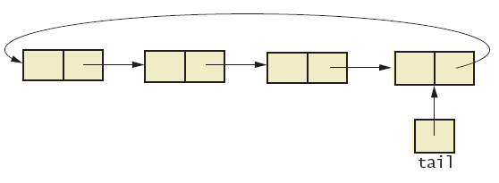
LinkedList variations
Consider having last link point back to head
  Creates a circular linked list

Slide 19
LinkedList variations
Also possible to have backward as well as forward links in the list
Doubly linked list
Possible to traverse in either direction

Slide 20
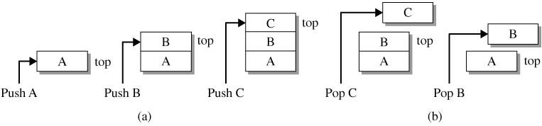
Stack
  A Stack is a collection with a single reference point called the top of the stack. An element is added at the top of the stack (push operation) and removed from the top of the stack (pop operation).
  Elements come off a stack in the reverse order of their insertion and so a stack has last-in-first-out (LIFO) ordering.

Slide 21
Stack
Page-visited history in a Web browser
Undo sequence in a text editor
Chain of method calls in the Java Virtual Machine
Validate XML
History of visited places in a game

Slide 22
Stack error
Stack s = new Stack();
for(int i = 0; i < 7; i++)
{
s.push( i );
}
for(int i = 0; i < s.size(); i++)
{
System.out.println( s.pop() );
}
// Output? Why?

Slide 23
Stack error corrected
Stack s = new Stack();
for(int i = 0; i < 7; i++){
s.push( i );}
int limit = s.size();
for(int i = 0; i < limit; i++){
System.out.println( s.pop() );}
//or
// while( !s.isEmpty() )
// System.out.println( s.pop() );

Slide 24
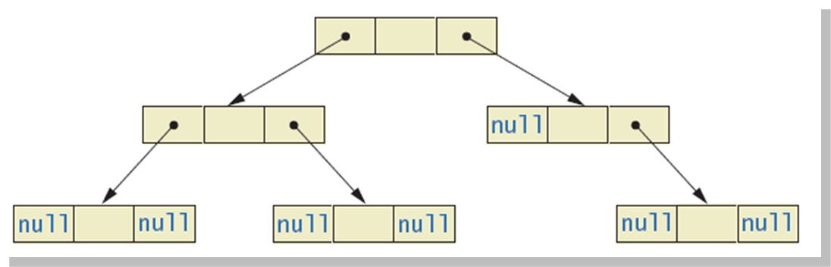
Tree Collection
Each node leads to multiple other nodes
Binary tree: each node leads to at most two other nodes

Slide 25
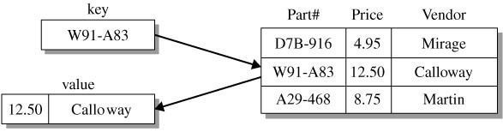
Map collection
A Map is a collection of key-value pairs. The key uniquely identifies the element while the value field typically has associated data. Access to an element requires only the key and returns the value component.
Ordered map: TreeMap
Unordered map: HashMap

Slide 26
Example
studid
name
score
0012345
andy
81.5
0033333
betty
90
0056789
david
56.8
...
9801010
peter
20
9802020
mary
100
...
9903030
tom
73
9908080
bill
49
Consider this problem. We want to store 1,000 student records and search them by student id.

Slide 27
Example
name
score
:
:
One ‘stupid’ way is to store the records in a huge array (index 0..9999999). The index is used as the student id, i.e. the record of the student with studid 0012345 is stored at A[12345]
andy
81.5
:
:
betty
90
:
:
david
56.8
:
:
:
:
bill
49
:
:

Slide 28
Example
Store the records in a huge array where the index corresponds to the key
  add - very fast O(1)
  delete - very fast O(1)
  search - very fast O(1)
But it wastes a lot of memory!

Slide 29
Hash function
function Hash(key: KeyType): integer;
Imagine that we have such a magic function Hash.
It maps the key (studid) of the 1000 records into the integers 0..999, one to one.
No two different keys maps to the same number.
H(‘0012345’) = 134
H(‘0033333’) = 67
H(‘0056789’) = 764
…
H(‘9908080’) = 3

